Slide 1


Stallion WMS
WMS Solution

Slide 2








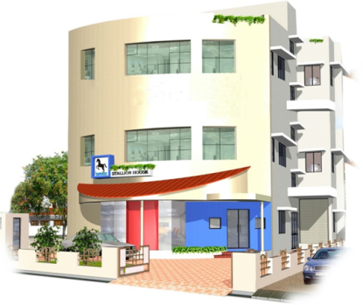
Headquartered in Kochi, Kerala, one of India’s leading IT hub
Wide reach with a nationwide network of 16 direct branch offices
International operations in UAE, Qatar & Oman
STALLION Highlights
About
Launched 2 decades ago, Stallion is a premium vendor in the AIDC industry providing solutions in India & Middle East.
  Tailor made solutions as per customer requirements in AIDC technologies like Barcode & RFID
  Wide range of cost effective RFID infrastructure
  Over 20000 privileged customers
  Manufacturing units at Kochi, Bangalore, Mumbai & Dubai (UAE) for tags & consumables
  POS terminals for Retail industry
  Proven track record in providing Warehouse, Asset & Inventory management solutions
  Document Archiving Solutions
  Solutions for Manufacturing Assembly Lines
  HR Real time monitoring Attendance Systems
  IT Asset Management Solutions

Slide 3
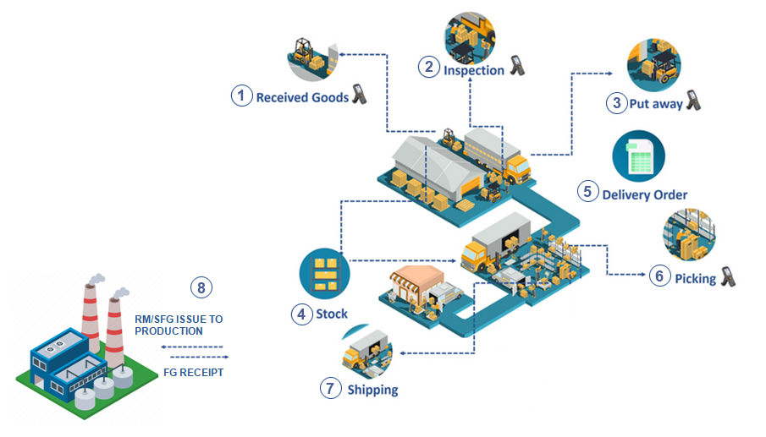
PROCESS COVERED

Slide 4
Solution overview
Best suitable hardwares from wide range of product portfolio
Integration with any third party ERP
Windows and Web Based Solution based on network availability
.
Dashboard to monitor material movements
Different levels of user permission’s
FIFO Based Despatch /Transfer/Export
Secured Data base & Maintenance plan
User friendly Screens for portable devices.
Auto Email,SMS alerts
.

Slide 5

Problems Vs Solutions
If no centralized inventory management system to handle the multiple warehouses across the region
Manual errors
Product ageing related issues because of manual picking
Misplaced inventory created issues during pick activity
Late notification to management low inventory level
Web based WMS application to control the inventory movement across all the warehouse
Product inward and outward through barcode based solution
FIFO based on manufacture date, ageing alerts based on shelf life
Location/Bin definition in WMS
Alerts on Iower inventory level to management based on master configuration
WMS Solution

Slide 6



Solution-Features
Stallion WMS.FLEXI
GRN
FIFO Wise Picklist
GRN of the material and barcode generation
FIFO based pick list to avoid ageing related issues
Inspection
Transfer & Receipt
Received material will be inspected and move to inventory
Dispatch /Export & receipt in other locations
Put away & Bin Management
SAP/NAV/Tally integration
Material will moved to bins by scanning material barcode and bin barcode
Seamless integration with other software's.

Slide 7
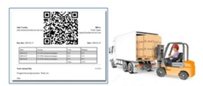

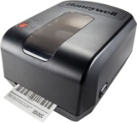


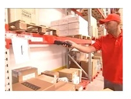
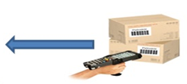
Material Inward & Putaway
Based on receipt of the product cartons/ pallets, receipts will be done at warehouses, GRN Data can be uploaded as excel into WMS or can be pushed from ERP using WMS API end points
After physical inspection for accepted quantity GRN /Inward will confirmed and QR code labels will get generated
User will load the GRN/Inward data to scanner by connecting to the base station though USB
Data
GRN DETAILS
INVENTORY REPORT ITEM LEVEL/BIN LEVEL
PRODUCT AGEING REPORT
TRACEBILITY OF TRANSACTIONS ALONG WITH TIME ,USER ETC
OUTPUT BACK TO ERP WITH INVENTORY DATA**
STALLION WMS SEREVER
User will scan and move the material to destination bins, after scanning data will get synchronised back to application server using USB cable
Storage and Bin scanning will be done using Wifi Scanner

Slide 8
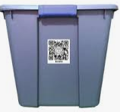
Material Issue for Production
"Picking wrong batch"
"Picked wrong item“ against PO
Delivery / Production order related information will be loaded to the WMS manually or from ERP as file upload or through API
Pick list will get generated from WMS based on production order data
As per suggested pick list user will move to the storage area and pick the material, scanned material move to despatch /production location. After picking device connected to base station though USB and load data back to server
MATERIAL ISSUE HISTORY
INVENTORY REPORT ITEM LEVEL/BIN LEVEL
PRODUCT AGEING REPORT
TRACEBILITY OF TRANSACTIONS ALONG WITH TIME ,USER ETC
NO then issue full quantity to production
YES
Partial Pick ?
Scan and move the partial quantity to transfer BIN / Bucket by scanning its QRCODE / BARCODE
STALLION WMS SEREVER

Slide 9

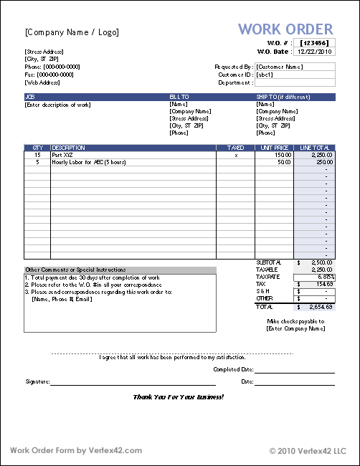
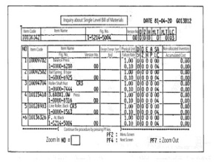
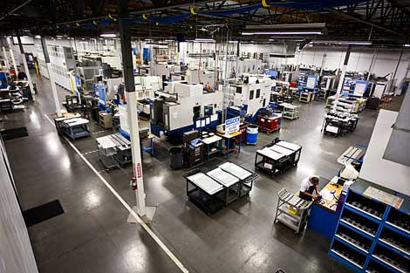
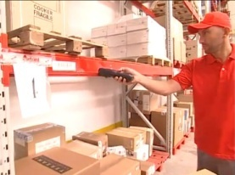

Production Order & Material Issue
STALLION WMS SERVER
PRODUCTION ORDER PREPARATION IN WMS AGAINST PRODUCTION PLAN FOR MATERIAL ISSUE
PRODUCTION AREA
MULTIPLE PRODUCTION ORDER CAN BE ISSUED AGAINST THE PRODUCTION PLAN FROM STALLION WMS
AGAINST PRODUCTION ORDER USER WILL SCAN THE MATERIALS FROM RM STORE BASED ON PICKLIST.PARTIAL PICKING IS ALLOWED
PICKED MATERIALS AGAINST THE PRODUCTIOn ORDER WILL BE CHANGED FROM ACTUAL STOCK TO WIP STOCK

Slide 10

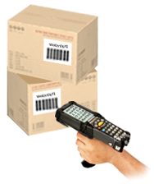

Production Confirmation & FG Receipt
AGAINST PRODUCTION ORDER USER WILL CONFIRM FG OUTPUT IN WMS
PACKING OF EACH PART NUMBER AGAINST STANDARD PACK SIZE AND BARCODE WILL BE GENERATED FOR FINISHED PRODUCTS
FINISHED PRODUCTS WILL GET MOVED TO FG WAREHOUSE AND PERFORM PUTAWAY
PRODUCTION HISTORY
QC HISTORY
FG INVENTORY CREATION
RM TO FG TRACEBILITY
AGE WISE FG INVENTORY WITH STORAGE LOCATIONS AND BINS
QUALITY CHECKING WILL AND APPROVAL ON FG BATCH IN WMS , ACCEPTED WILL BE READY FOR DESPATCH

Slide 11
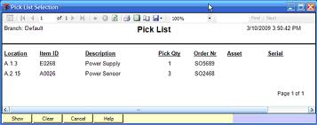
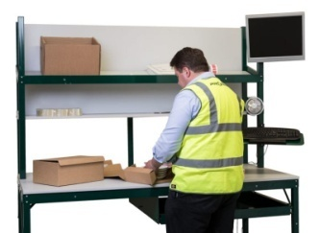

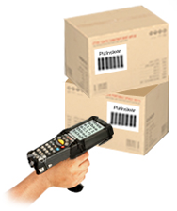
Despatch / Transfer
"Picking wrong batch"
"Picked wrong item“ against PO
DESPATCH PICKLIST WILL BE GENERATED FROM WMS AGAINST DESPATCH PLAN
USER WILL FOLLOW PICKLIST AND PICK THE MATERIAL FROM BIN LOCATION
STALLION WMS SERVER
DESPATCH HISTORY
FIFO VALIDATIONS
FG INVENTORY UPDATION
RM TO FG TRACEBILITY
DESPATCH SCANNING TO CONFIRM THE MATERIAL MOVEMENTS FROM WAREHOUSE

Slide 12
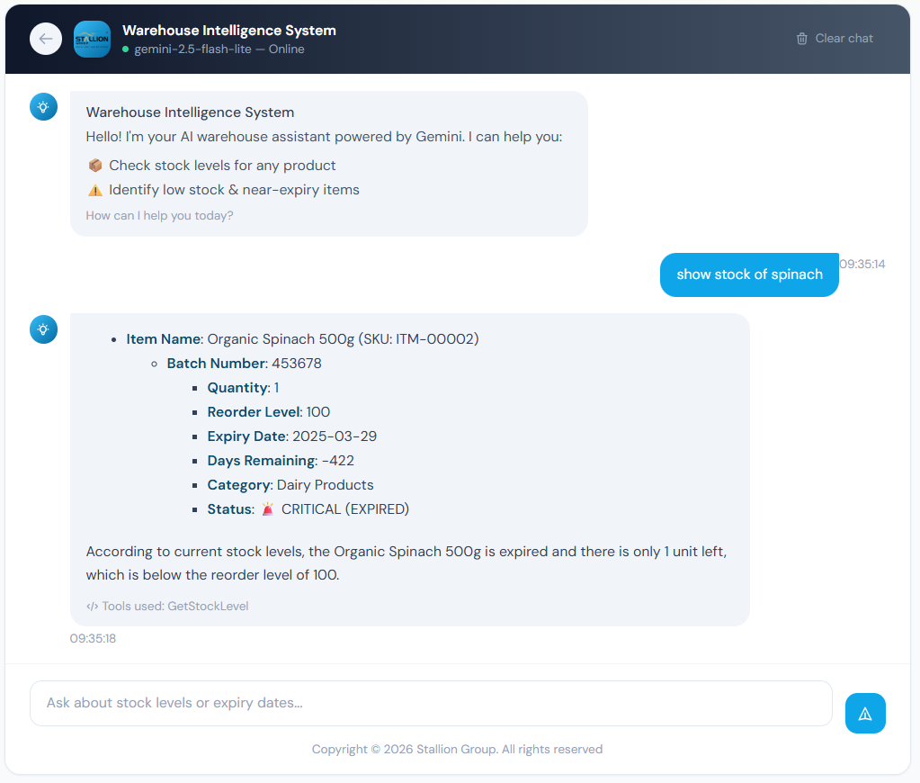
AI Chat Assistant
Powered by Google Gemini
Check stock levels for any product
Identify low stock items
Get near-expiry items
Check expiry date of items

Slide 13
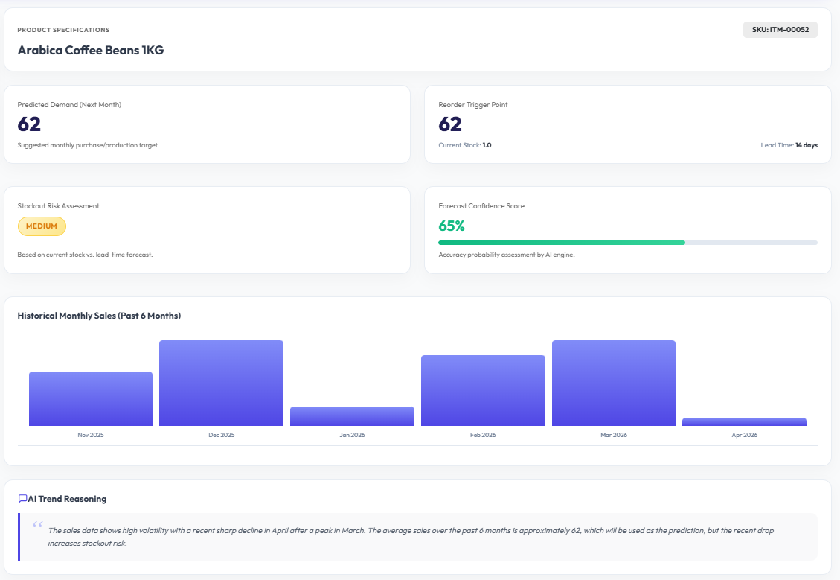
AI Demand Forecasting
Powered by Google Gemini
Use historical data to calculate sales forecast for the month
Use historical data to calculate dynamic reorder points. Instead of a static "reorder at 10 units," the AI adjusts based on seasonality (e.g., "reorder at 50 units in December, but 5 in July")

Slide 14
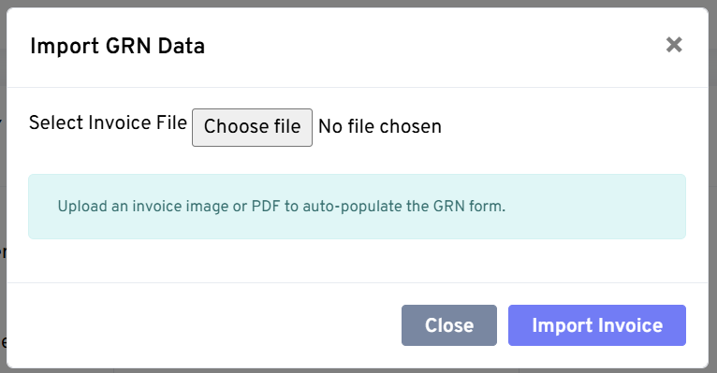
AI GRN Entry Automation
Powered by Google Gemini
Import GRN data from Image or PDF
Extract Invoice no, date, Vendor, Item, Rate, Qty, Mfg date, Exp date etc.
Eliminates data entry challenges/mistakes
Faster GRN Entry

Slide 15
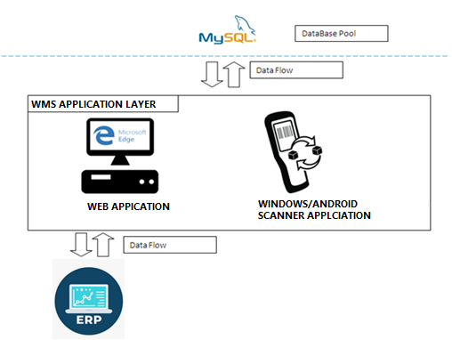
System
Architecture
The architecture which was a Blend of various available technologies which suited for the scope of the project as well as the Production environment
Windows Application/Web based application for Barcode printing.
APIs for third party application integration
Modules for mobile devices in the warehouse for scanning the material movement

Slide 16

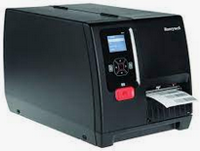
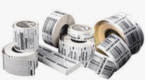

Solution portfolio
Item Type |  | Model | Purpose
WMS Software |  | WMS software to handle different operations as mentioned in above slides | To handle different barcode based transactions
Portable scanner |  | Model to be finalized | To handle scanning of the Barcode, during putaway, pick, Dispatch, PV etc
Barcode printer |  | Printer model to be finalized | Will be used to generate barcode labels for cartons
Barcode label |  | Label Size & Material to be finalized | For carton labels
Ribbon |  | Ribbon Size & Material to be finalized | To print labels

Slide 17
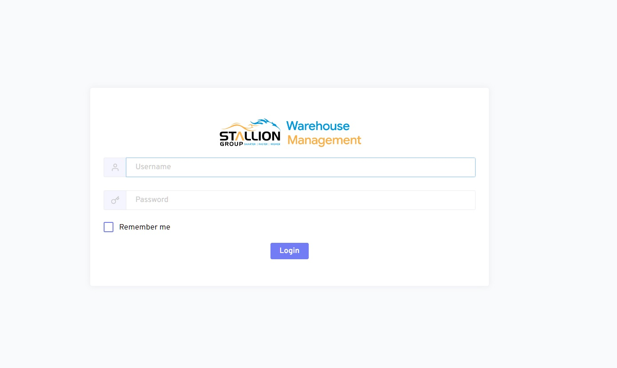
SNAPS OF STALLION WMS

Slide 18
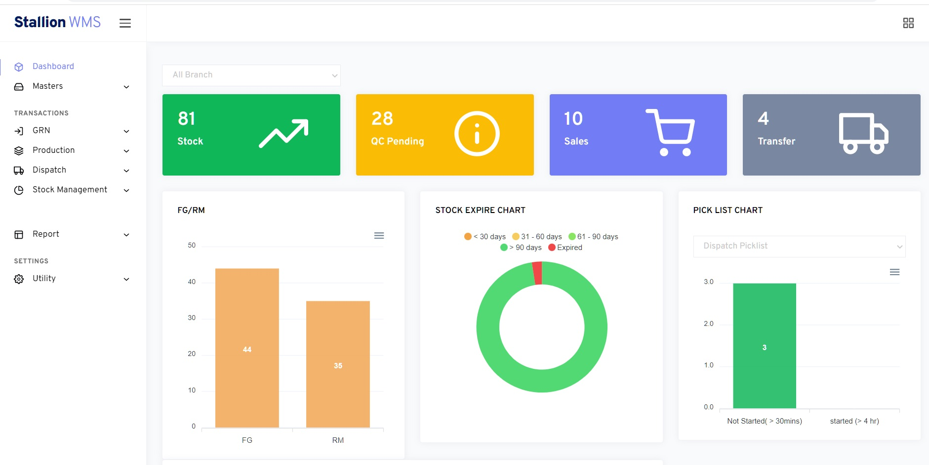
SNAPS OF STALLION WMS

Slide 19
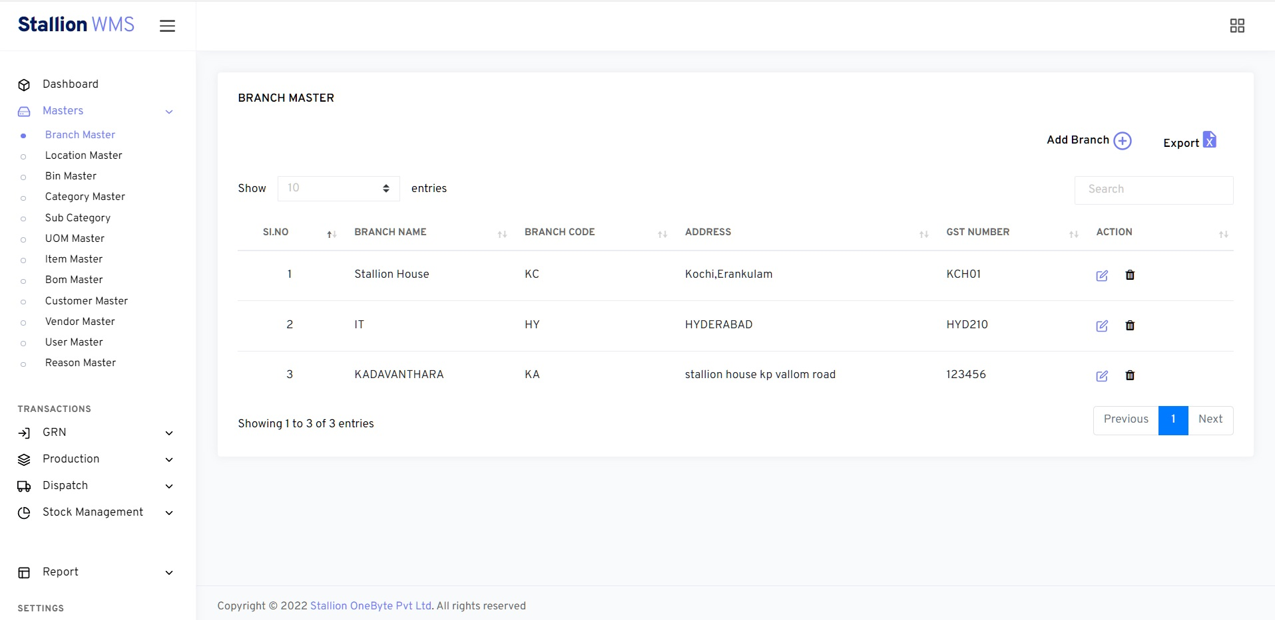
SNAPS OF STALLION WMS

Slide 20
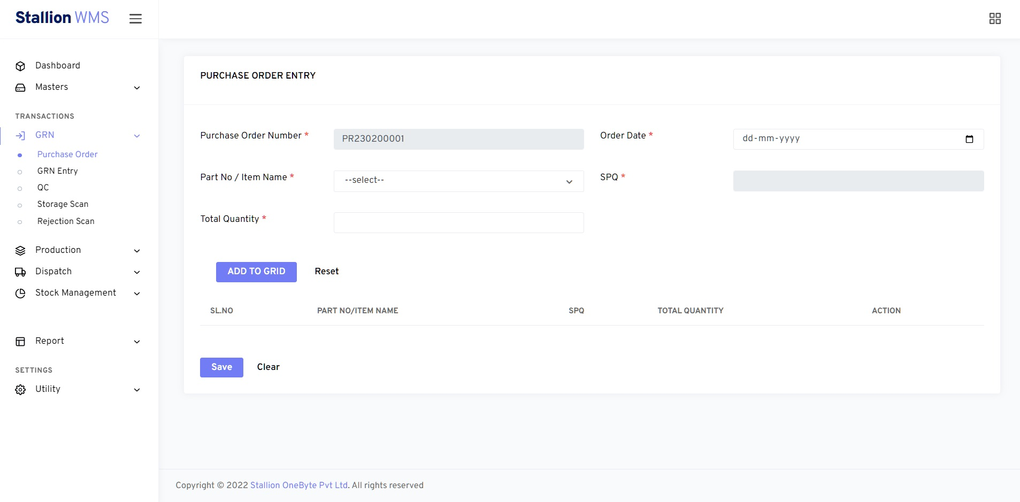
SNAPS OF STALLION WMS

Slide 21
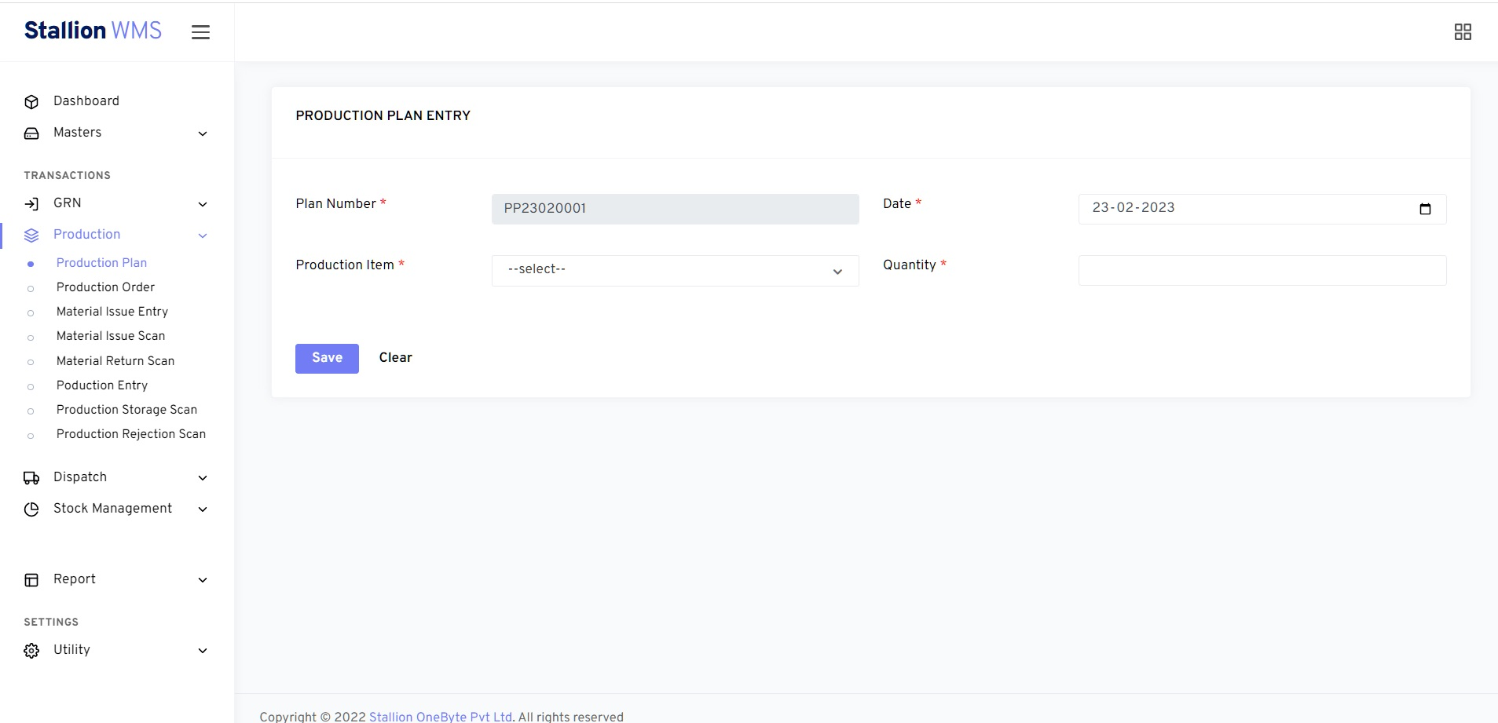
SNAPS OF STALLION WMS

Slide 22
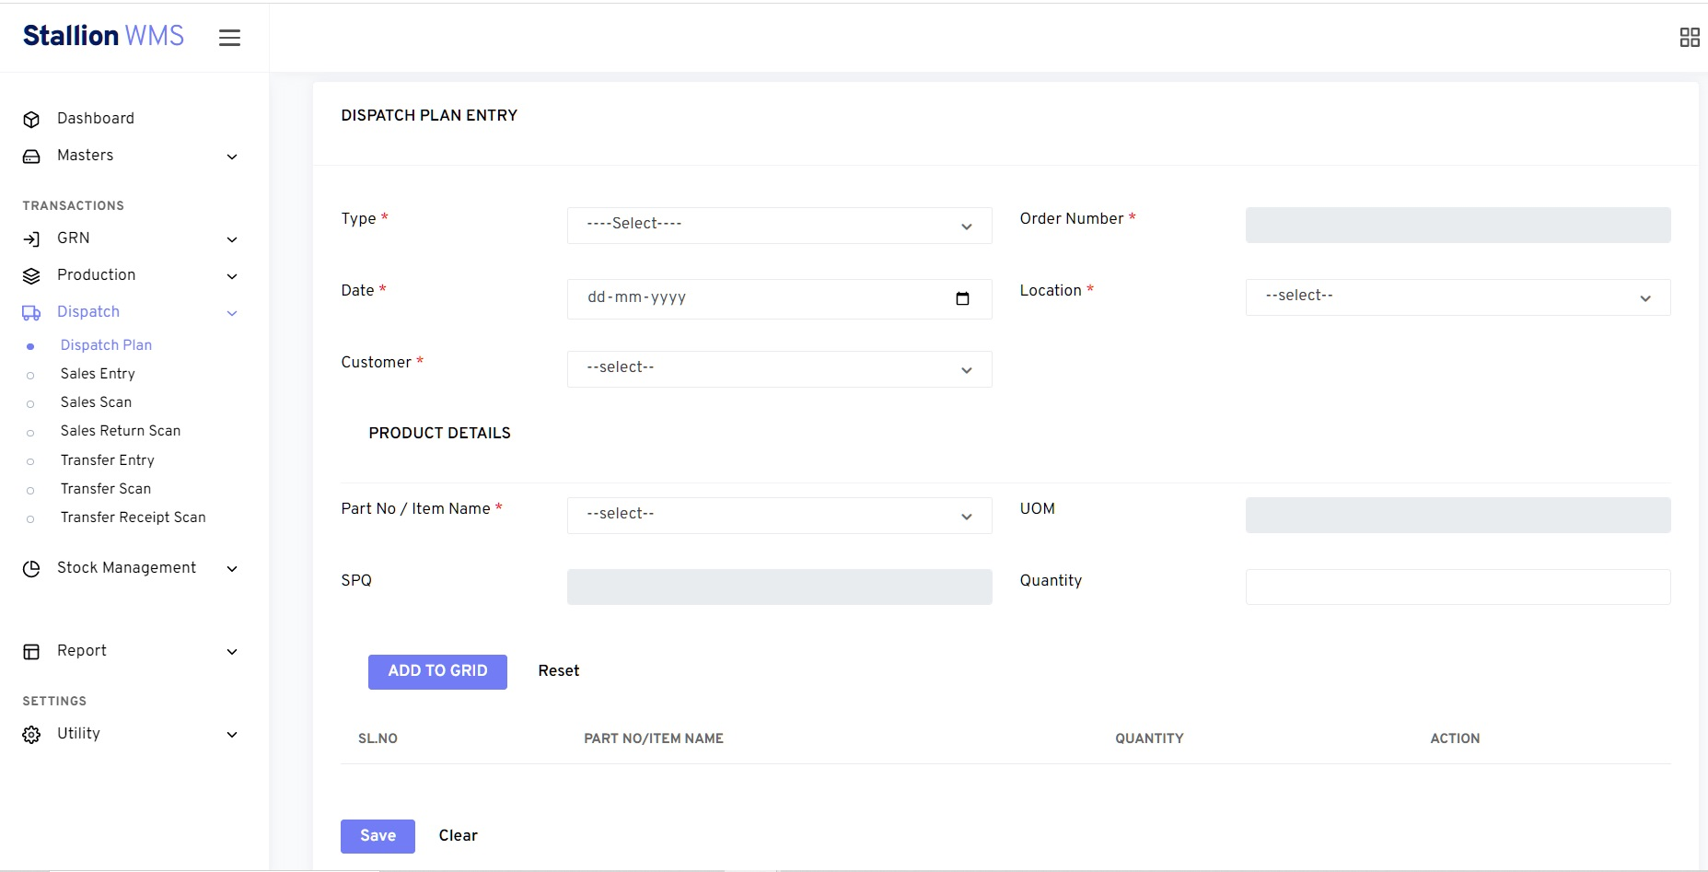
SNAPS OF STALLION WMS

Slide 23
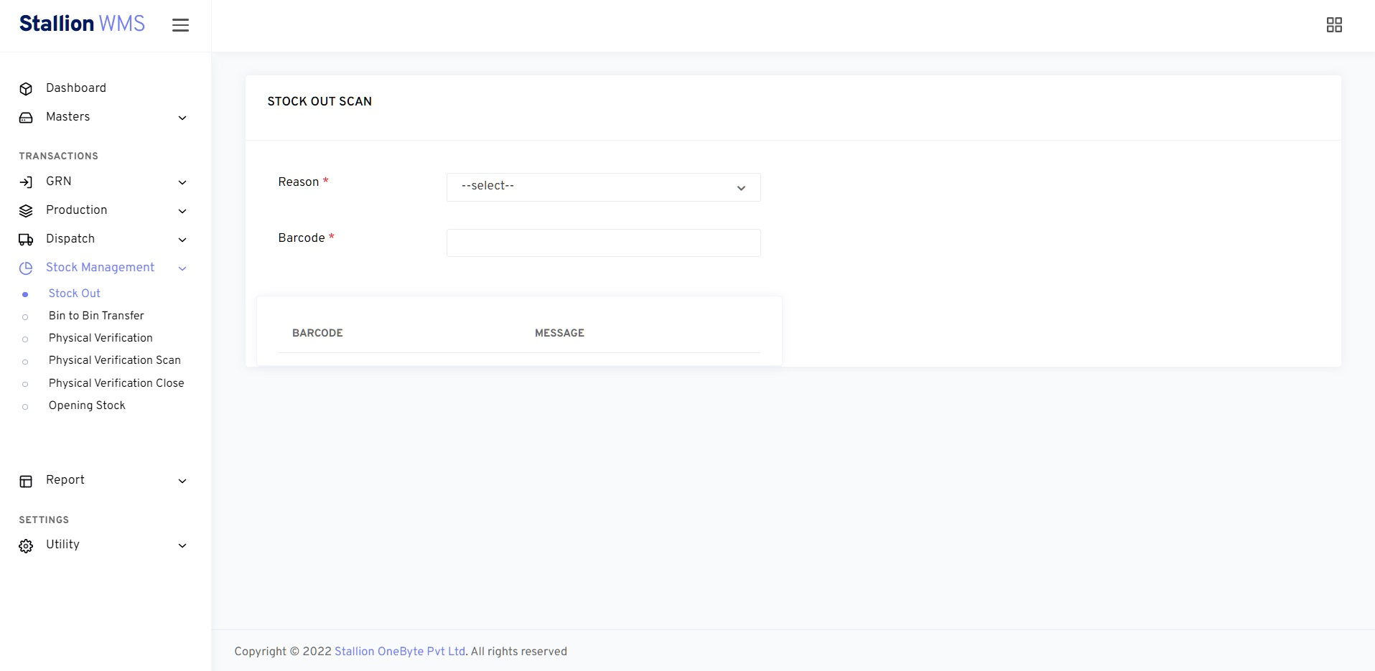
SNAPS OF STALLION WMS

Slide 24
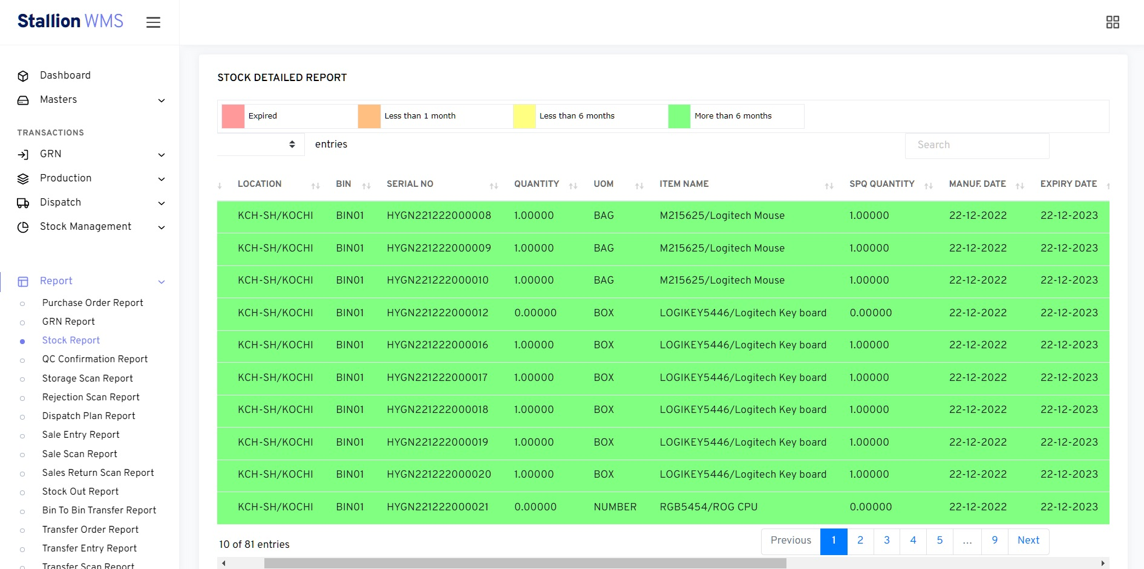
SNAPS OF STALLION WMS

Slide 25
Thanks You
THANK Y
For your wathcing

